Slide 1
Horizon Europe Support Schemes
Framework Programme Unit

Slide 2
ABOUT US
Framework Programme Unit
Xjenza Malta is mandated by the national government to act as the National Contact Point (NCP) Organisation for the EU R&I Framework Programme as well as representing Malta as Programme Committee Member (PCM) for each thematic area.
NCPs provide specialised knowledge and guidance in their respective areas to support and actively encourage local stakeholders to participate in the R&I Framework Programme.
PCMs assist the European Commission in implementing the programme through strategic discussions on planning and ensuring links to nationally funded research activities. Negotiations of the Work Programmes and calls are the primary focus of the PCMs' work.
Mission Statement:
To provide highly professional support services by spreading awareness, giving specialised advice, and providing on-the-ground guidance to Maltese researchers and entities and ensuring that the new Framework Programme, Horizon Europe becomes known and readily accessible to all potential applicants.
xjenzamalta.mt

Slide 3
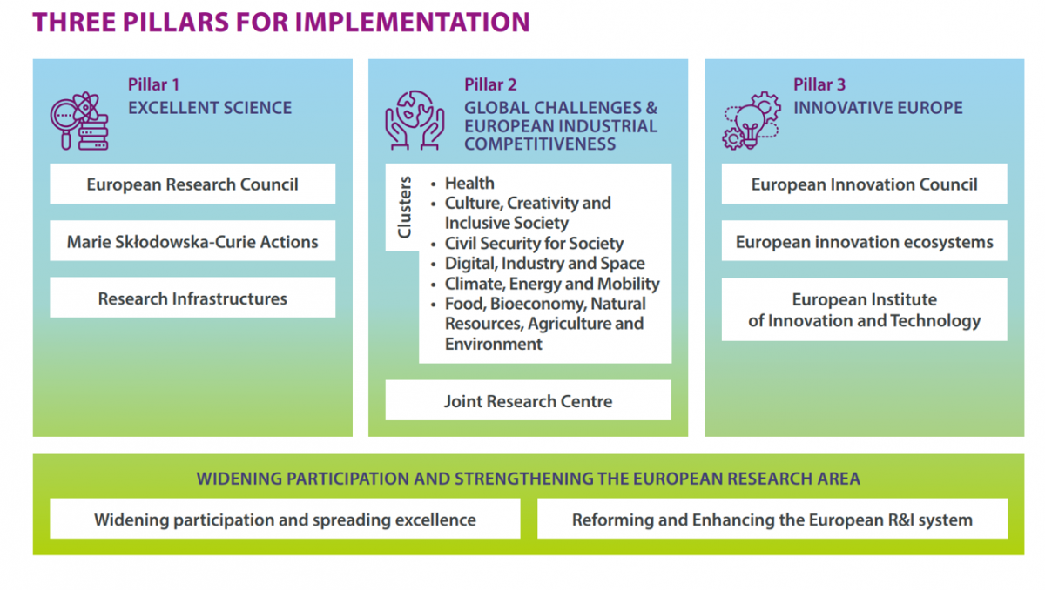
Horizon Europe 2021 – 2027
€95B
Horizon 2020 Introduction
€25.8B €52.7B €13.6B

Slide 4
Horizon Europe Support Schemes
National Budget 2025 – Eur 200k
HIPAS
PF2MT
ERC Support Scheme
EIC Support Scheme
NET2HE
1
2
xjenzamalta.mt

Slide 6
HIPAS 1/3
Support for Maltese entities intending to submit a Horizon Europe/partnership proposal as Coordinator to engage a service provider (proposal writer/graphic designer)
Covers all Horizon Europe calls
3 Cut offs in 2025:
15 April 2025
27 June 2025
7 November 2025 (final deadline)
Call page with documents and templates

Slide 7
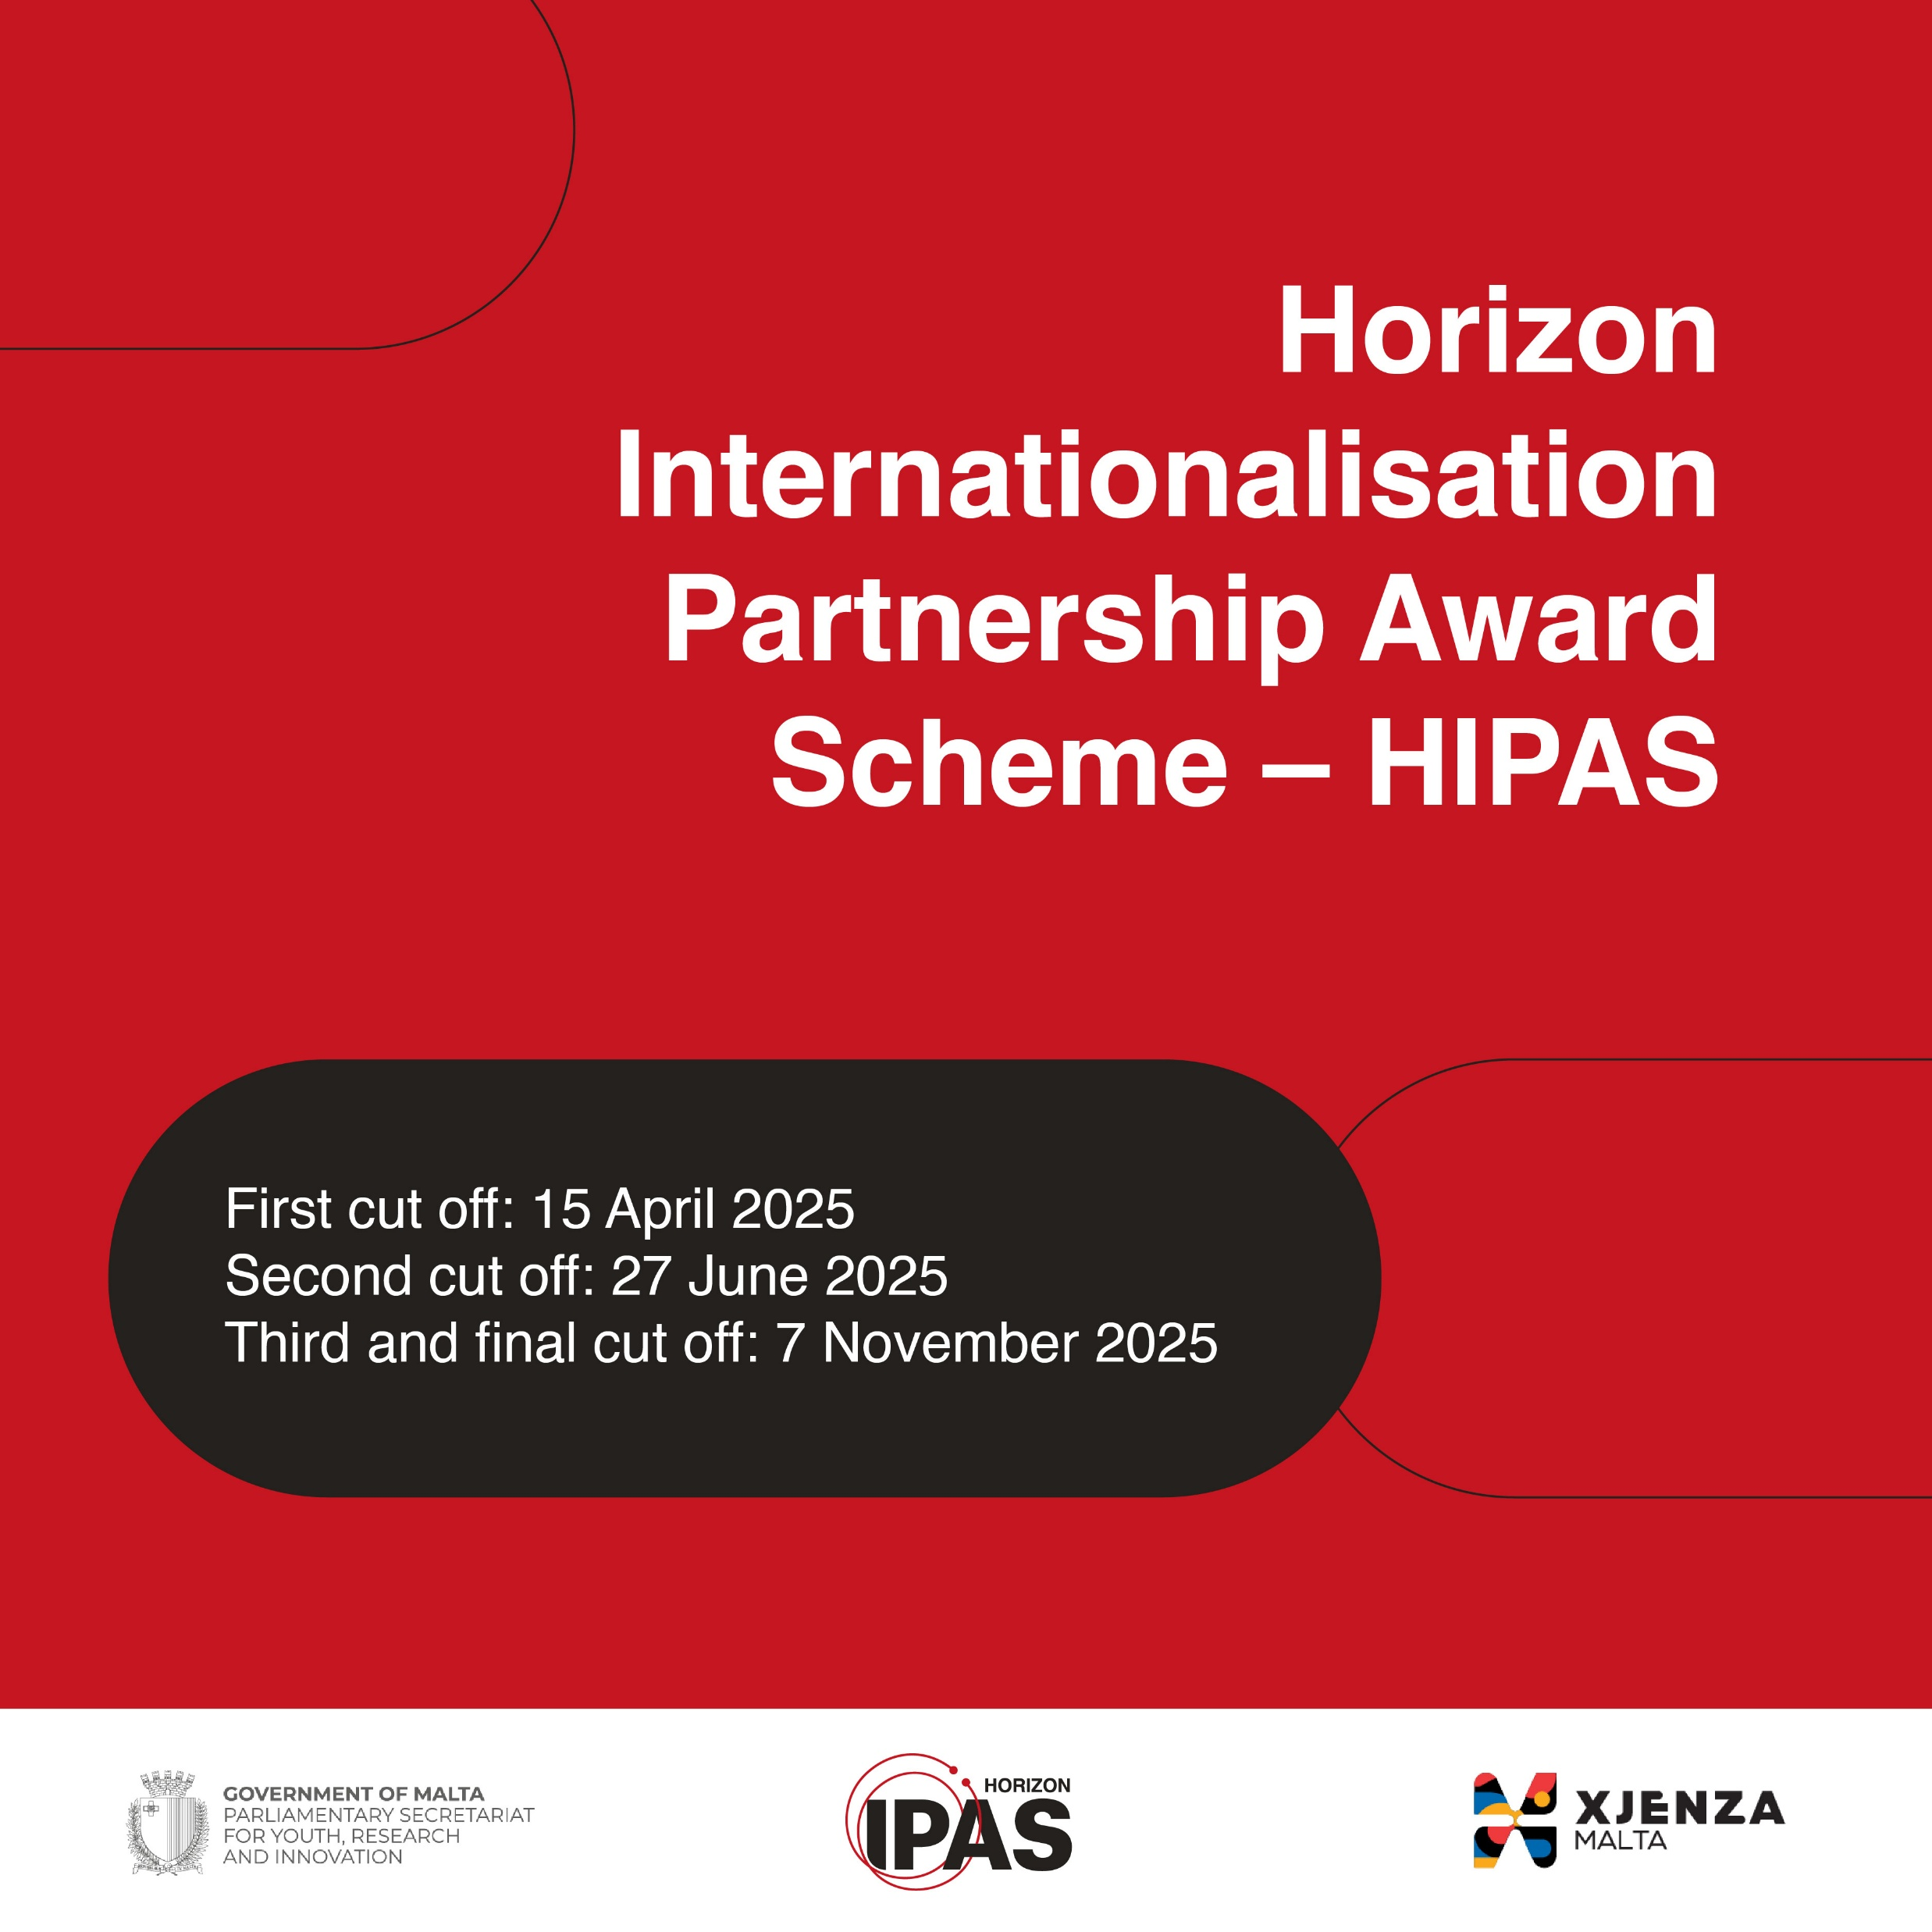
HIPAS 2/3
Financing through reimbursement:
Up to Eur 8,000 of which max Eur 1,000 for graphic designer
Exceptions:
Up to Eur 2,500 for the MSCA Postdoctoral Fellowship call
Important:
the service provider cannot be part of the project consortium
1 year to implement the activities
Final report + supporting documents

Slide 8
HIPAS 3/3
External evaluators will score the proposal according to the following evaluation criteria:
➢ Excellence of the proposed project idea (project’s brief) and relevance to the pre-identified call topic.
➢ Proven track record of the proposed consultancy individuals/firms, including a list of other Horizon Europe/Horizon 2020/FP7 projects that have been supported in the past.
➢ Quality of the proposed consortium partners, makeup, distribution, diversity (academic, public, private), if applicable.

Slide 9
PF2MT 1/2
Aims : Supports travel and accommodation expenses for experienced researchers (Phd holders) willing to submit a proposal with Maltese entity host for the MSCA Postdoctoral Fellowship call.
MSCA PF masterclass training: 18th and 19th June 2025
Researchers, from any nationality and any age, that meet the eligibility and mobility conditions, may apply through this scheme.
Funding:
TC – flat rate of Eur 2,000
EU/AC – flat rate of Eur 800
The call will open in March until 8th June 2025

Slide 10
PF2MT 2/2
How it works?
Researchers identify and contact supervisor from Malta
Submission of PF2MT application form → administrative check
Researchers attend the masterclass
50% financing following participation and 50% following submission of the proposal to the MSCA PF 2025 call
Interested to host postdocs?
Expressions of interests for supervisors
Worldwide promotion

Slide 11
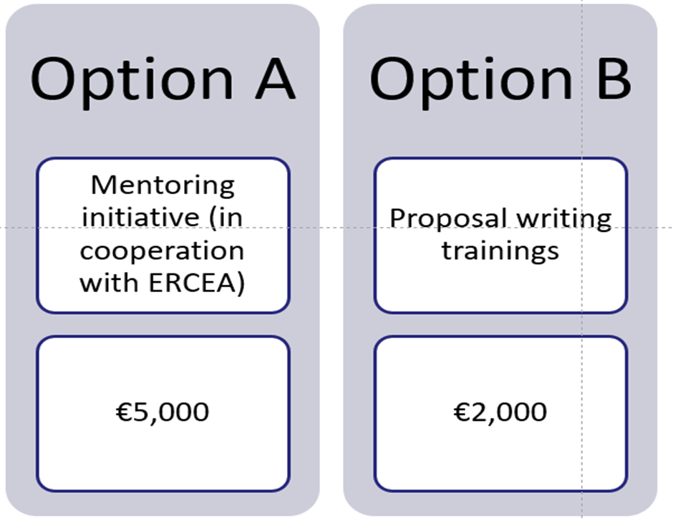
ERC Support Scheme 1/2
Aims: Strengthen the opportunities for talented researchers to obtain grants from the European Research Council (ERC) for excellent and ground-breaking research based on researchers’ own ideas within all areas of research.
The call is open until end of the year with 3 cut offs:
28 March 2025
20 June 2025
26 September 2025 (final deadline)
Additional support for interview preparation (up to € 3,000)

Slide 12
ERC Support Scheme 2/2
Short application form including project brief and selected training (for Option B)
External evaluation
No Grant Agreement
100% reimbursement upon submission of final report, supporting docs and proof of submission
Option A: List of mentors provided by ERCEA. Travel cost to the mentor is also eligible
Option B: Online or on-site training
Call page with rules and application form

Slide 13
EIC Support Scheme 1/3
Support for Maltese entities intending to submit a proposal to the European Innovation Council as Coordinator of a consortium or sole applicants to engage:
A) Grant writing consultant (up to EUR 10k) – All calls
B) Business Coach (up to EUR 5k) – Accelerator Stage 1 only
C) Pitch Coach (up to EUR 2k) – Transition Stage 2 & Accelerator Stage 1
The application itself is very simple, all forms can be found on the website. We require:
Concept note, profiles of 3 consultants you are considering engaging, de minimis declaration (for profit-making entities), and proof you submitted!

Slide 14
EIC Support Scheme 2/3
The cut-offs are always 4 months before the relevant EIC cut-offs:
EIC Pathfinder Open 21/05/25 → Our cut-off: 21/01/25
EIC Pathfinder Challenges 29/10/25 →Our cut-off: 29/06/25
EIC Transition 17/09/25 → Our cut-off: 17/05/25
EIC Accelerator Open & Challenges – Stage 1 always open, stage 2 cut-offs: 12/03/25 & 1/10/25 → Our cut-off: 12/12/24 & 1/06/25
Call page with documents and templates

Slide 16
NET2HE
Support Scheme - Eligible costs
Flights for travel related to the event (the total amount should be estimated as costing no more than €750 for both EU Member States and for Associated Countries and should be an economy class ticket, this capping also covers the travel insurance).
Subsistence allowance of €150 flat rate per night (The flat rate will reflect the duration of the event and the number of nights required).
Max amount of days for same brokerage event/info is 5 days, reimbursed up to 5 nights
Upon receipt of the requested reporting documents, you will be reimbursed
xjenzamalta.mt

Slide 17
Application process
Step 1: Make use of the “list of suggested events” that is regularly updated on our website/email us with an event that you think is relevant for you to attend that has a Horizon Europe networking element.
Step 2 : Hand in your application at least 15 working days before the start of the event.
With your application you need to attach :
Agenda of the activities
Proof that your registration has been accepted by the organiser
3 flight quotations (direct flights are preferred)

Slide 18
Upcoming events
Event Name | Location | Dates | Thematic area/s | Details
European Ocean days | Brussels, Belgium | 3-7 March | Ocean Mission, Marine, Environment | European Ocean Days - European Commission
Successful R&I in Europe 2025 | Dusseldorf, Germany | 6-7 March | Health, Culture, Digital tech, Industrial tech, Energy, Mobility, Food, Environment | Successful R & I in Europe 2025 – Horizont NRW
EIC Summit | Brussels, Belgium | 2-3 april | EIC | https://eic.ec.europa.eu/events/save-date-next-edition-eic-summit-2025-04-02_en
SM12G Brokerage Event | Paris, France | 6-7 May | Civil Security for Society | SMI2G - Security Mission Information & Innovation Group Event 2025 - Paris | Crisis Management Innovation Network Europe (CMINE)

Slide 19
State Aid
For applicants that qualify as undertakings that carry out an economic activity within the meaning of Article 107 TFEU, all Horizon Support Schemes (apart from PF2MT) will be implemented in line with the de Minimis Regulation (Commission Regulation (EU) 2023/2831 of 13 December 2023 on the application of Articles 107 and 108 of the Treaty on the Functioning of the European Union to de minimis aid).
Therefore, if you fall under state aid rules, you need to attach the “state aid declaration”.

Slide 20
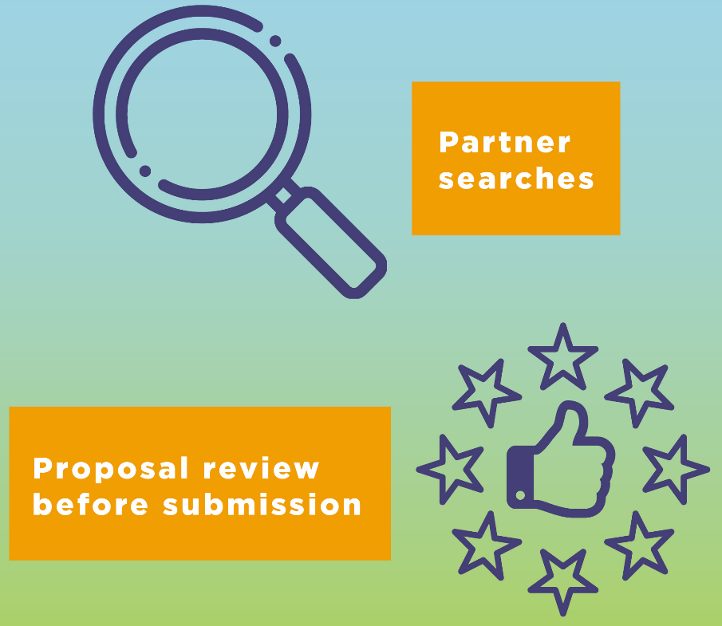
National Contact Points

Slide 21
THANK YOU
horizon.malta@gov.mt
Follow us on:

