Slide 1






The R&I Unit
Supporting Excellence in Research

Slide 2

About Us
The Research and Innovation Unit manages three national funding portfolios: FUSION, Thematic Programmes and the Research Networking Scheme.
In 2025, the budgetary allocation for the R&I unit has increased to €9M.
The R&I Unit manages schemes that fund projects across all levels of RDI i.e., networking, basic research, applied research as well as commercialisation.

Slide 3
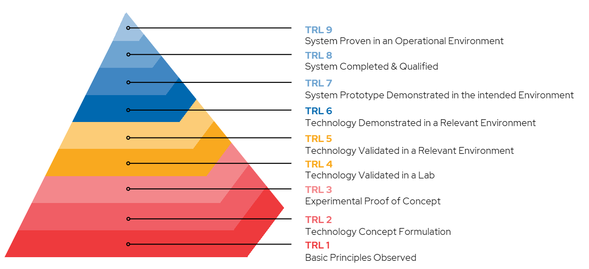
Technology Readiness Level
Funding schemes within the R&I Unit span across both early stage and applied research, thus targeting research between TRL 1 – TRL 8.
Notes:
Please note that “Technology” is defined as the application of knowledge and tools
to solve problems, enhance capabilities, or improve efficiency across various fields.

Slide 4
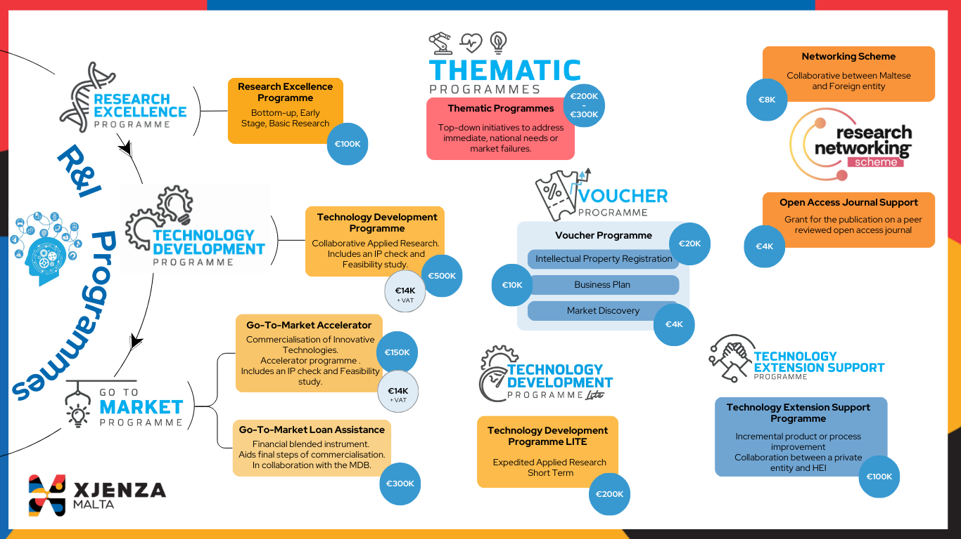
Notes:
The following infographic summarises the initiatives hosted by the R&I Unit; Starting with the most basic schemes RNS and REP
Contrary to REP are the Thematic Programmes
Under the umbrella of FUSION Programme (national programme for R&I for novel tech development) there is the TDP (largest pot of funding) and GTM.
TDP Lite is an expedited variant of TDP for applicants who don’t have a collaborator and want a faster process (1-1.5 YRS)
GTM loan assistance is still in the pipeline to be launched this year (2025)

Slide 5
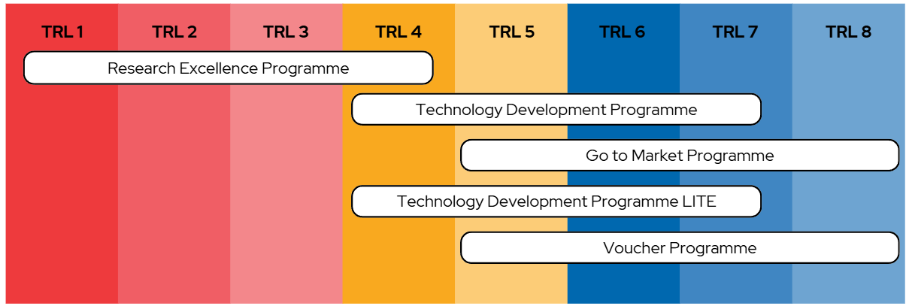
The R&I Unit – Programmes & TRLs
Programmes not categorised by TRLs:
Technology Extension Support Program (TESP)
Research Networking Scheme
Thematic Programmes

Slide 6

R&I Thematic Programmes
Objectives
To support innovative projects through specific, top-down initiatives through collaboration with other Maltese Public Entities and Authorities.
Two programmes were launched In 2024 in collaboration with MDIA and the Cancer R&I Foundation.
To develop a cohesive R&I landscape in Malta
To create dedicated, sector-specific support
To engage with the Maltese R&I community
To concentrate the efforts of Maltese researchers and entrepreneurs into addressing topics of national interest

Slide 7

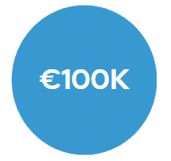
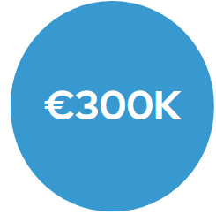
R&I Thematic Programmes
2025
OBESITY RESEARCH PROGRAMME – collaboration with the Ministry for Health and Active Ageing (MHAA)
Digital Technologies Programme (DTP) – collaboration with the Malta Digital Innovation Authority (MDIA)
Priority areas:
Food Labelling
Food Provision
Food Promotion
End April
Priority areas:
Artificial Intelligence
Digital Trust
Knowledge and Data Representation and Analysis
Technology for Sustainability and ESG
Quantum Computing and Other Emerging Technologies
March
CANCER RESEARCH PROGRAM - collaboration with the Cancer Research & Innovation Hub Malta (CRIHM)
Priority areas:
Molecular Research and Diagnostic Innovations
Community-Based Cancer Research
Therapeutic Development and Clinical Strategies
Psychosocial Support and Patient-Centred Approaches
2024 call: 4 Projects Awarded – 1 per priority area.
2025 call: 7 Projects Awarded – 1 per priority area. Designated according to evaluation rank.
March

Slide 8
R&I Thematic Programmes
≥2026
Climate Change Ministry for the Environment, Energy & Regeneration of the grand Harbour (MEER)
Social Science/Poverty - Ministry for social policy and children's rights (MSPCR)
Construction and Demolition Waste – Environment & Resources Authority (ERA)
Sustainability in Tourism Development – Malta Tourism Agency (MTA)
Energy and Water – Energy & Water Agency (EWA)
Notes:
Possible thematic programmes for the next coming years.

Slide 9

Research Networking Support
3/4 of 2025
2
Networking Scheme
Open Access Journal Support (open call)
Opportunities for collaborative initiatives with at least one foreign entity
Support of up to €8,000 for short term placements, workshops, development proposals, etc.
Supports beneficiaries of Xjenza Malta Research grants to publish their research in an open access journal with up to €4,000.
Notes:
The call will be later in the year
Open Access will have a later deadline making it an open call
No more opportunity to apply in conjunction

Slide 10


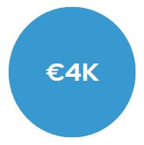
Vouchers Programme
Intellectual Property Registration (IPR)
Business Plan
This will provide the financial and operational plan of a start-up whilst acting as a blueprint from time of launch to several years in the future.
Duration: 12 Months
Validity of Voucher : 1 year.
Types of IPR:
Trademark
Copyright
Industrial Design
Trade Secrets
Patent
Levels of IPR:
National Level
EU Level
International level
Validity of Voucher: 3.5 years
Duration: 36 Months
Market Discovery
This will provide the right opportunities through which the technology/product/service can be showcased to potential investors.
Aims to prepare the beneficiary with the right tools when meeting potential investors.
Duration: 12 Months
Validity of Voucher: 1 year.

Slide 11


Space initiatives
ESA Plan for European Cooperating States (PECS) :
An investment by the Maltese Government by means of a programme intended to provide Maltese public, private and academic institutions with an opportunity to submit proposals for various calls.
ESA PECS Activity Types:
Research and Preparatory Activities
Flight and Ground segment related research and development activities
Space science activities
Space (downstream) Applications
Education activities
Contact Space Executive Dr Michael Quinton for more information: michael.quinton@gov.mt

Slide 12
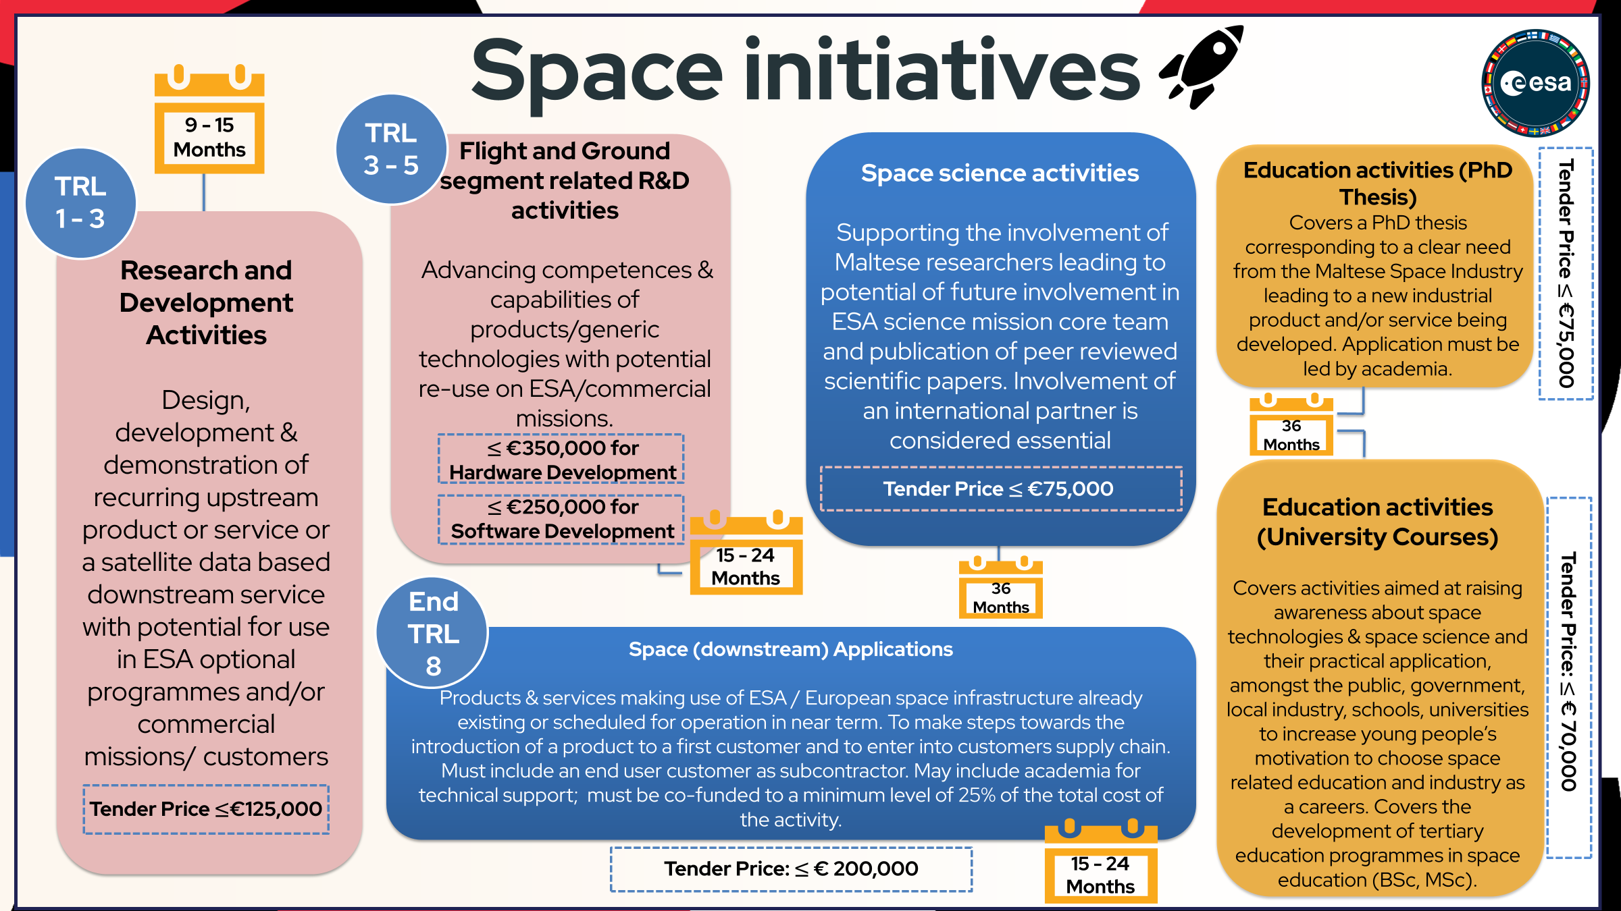

Slide 13
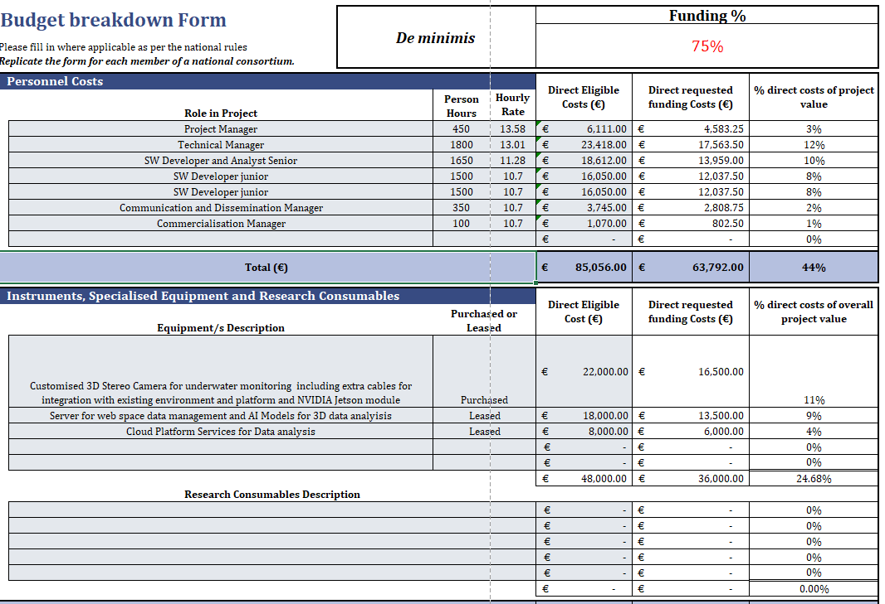
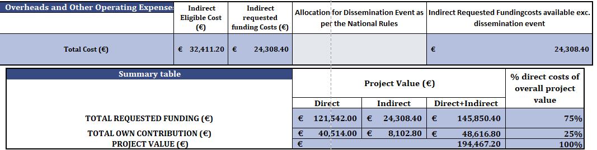
Example of a Budget Breakdown

Slide 14






CONTACT
xjenzamalta.mt
giulia.aquilina@gov.mt
mariah.vella.5@gov.mt
+356 2360 2197 +356 2360 2114
XJENZA MALTA
VILLA BIGHI, DAWRET FRA GIOVANNI BICHI
KALKARA, KKR 1320

